Slide 1
Introduction to SharePoint add-in model transition
Name
Title
Company

Slide 2
Agenda
Introduction
Transition process
Add-in model principles
Customization considerations
Notes:
Introduction to add-in model and transformation
Technical introduction
Why not farm solutions (full trust code) or sandbox solutions?
Recommendations for add-in model implementations
Process and approach
What to consider in existing farm solutions
If you still write farm solutions, what should you consider to make future transformation easier?

Slide 3
Developer vision
USERS
DATA
HTML
Notes:
Our Office 365 developer vision focuses on the Users’ experience and their data. As a developer you can bring your applications into their user experience. With over 1.2+ billion users of Office Worldwide, this is a huge opportunity to provide a window into your applications. As well as being able to connect into their data and add intelligence to your applications. There are currently 850 million events created a month and a total of 470Pb+ of data stored in the service that can add value to for our Users’.

Slide 4
Recommendations
Align with service and product roadmap
Avoid Sandbox solutions
Move gradually to add-in model
Concentrate on end users
Notes:
Vesa

Slide 5
Introduction

Slide 6


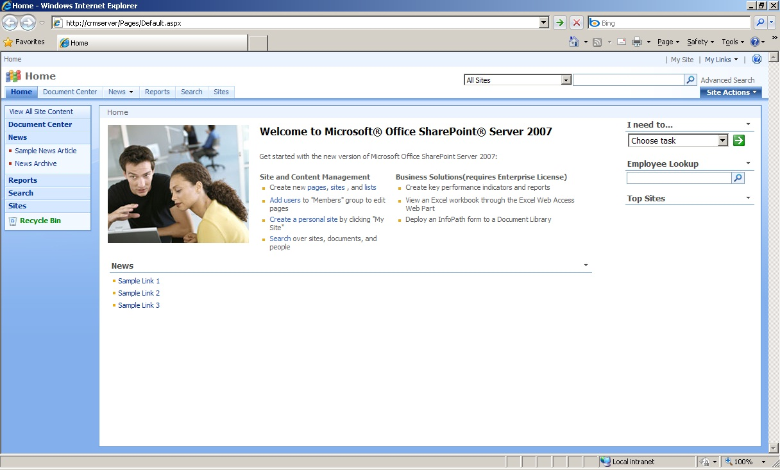
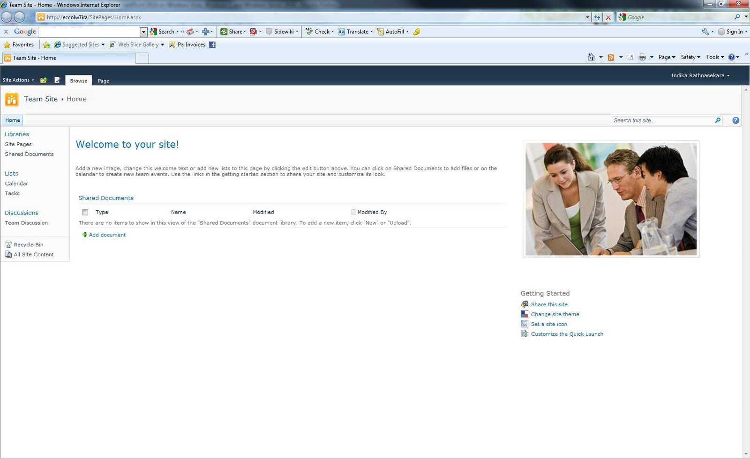
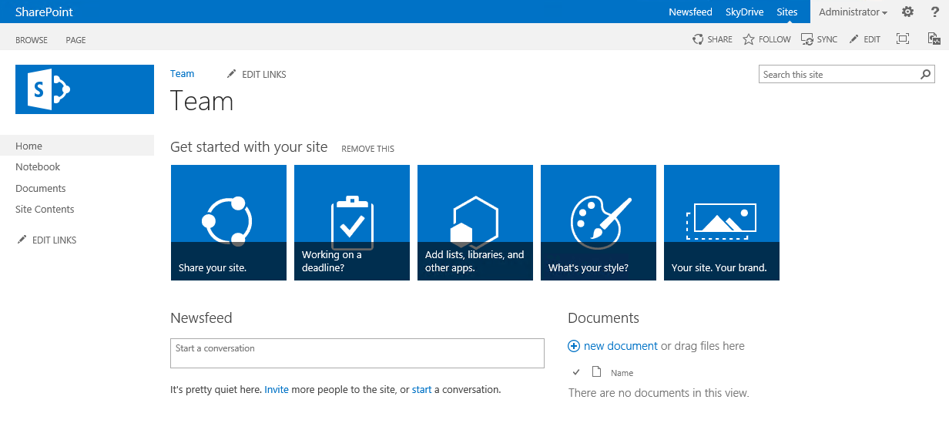
SharePoint evolves…
Provider Hosted Add-Ins
C#
SharePoint 2007
SharePoint 2010
C#
SharePoint 2013
C#
Sandbox
_api
C#
JS
JS

Slide 7
Full trust solution challenges
Full trust solutions with ghosted files
Implications to Disaster Recovery model
Deployments always cause downtime
Impact on Service Level Agreements as well as availability
Very expensive to maintain enough Infrastructure to reach “near zero”
Full trust solutions have to be closely analyzed
Do you trust your solution fully?
Complex Application Lifecycle Management processes
Not available in Office 365 (Multi-Tenant or Dedicated vNext)

Slide 8
“Will Farm Solutions be Deprecated soon ?!?!?”
No.
We use these approaches to build the product ourselves. BUT, many service providers (not just Office365) restrict their usage for the known challenges they impose.
Notes:
Vesa

Slide 9
What about sandbox solutions?
Code behind sandbox solutions are deprecated
Shows the direction where we are heading
No centralized control for sandbox solutions
No enterprise level capabilities for controlling available solutions
Possible orphan issues with deactivation
Still based on feature framework with it’s caveats
“We deployed custom default.aspx and now things are broken”
Requires deep understanding of SharePoint’isms
Notes:
Steve
Time: 13:00

Slide 10
“Wait? No feature framework?”
We are indeed gradually moving away from feature framework to alternative patterns…
Notes:
Steve
Time: 15:00

Slide 11
Customization Development and Deployment Options
Farm
Full trust solutions
Sandbox
Declarative elements
Partially trusted code service still included for limited server side support
SP Add-Ins
New add-in model
Customizations to file system of servers
Deployed from corporate catalog or SharePoint store
Manage permission and licenses specifically
Classic model from 2007
Preferred option
Hosted in same process as SharePoint
Server side SharePoint API access
Hosted in isolated process
Limited server side SharePoint API access
Simple install and upgrade process
Code behind Sandbox solutions deprecated
Notes:
Steve
Time: 16:00

Slide 12





Approaching add-in implementations
Readiness
Assessment
Planning
Implementation
Deployment
Readiness with add-in model topics
Hosting decisions
Network impact analysis
Development model readiness
Analyze possible existing solution usage, including both code and functionality
Concentrate on business and functional requirements, not on technology
Add-In model solution planning and design
What patterns and models are used for different solutions
What solutions can be converted to out of the box capabilities?
Detailed technical planning
Actual add-in model solution implementation
Typical development process, including testing
Add-In solution deployment
Existing content retrofitting
Farm solution retraction
Time for accurate estimates

Slide 13
Concentrate on functional requirements, not the technology
There are numerous ways to achieve a similar end result, don’t get stuck on what you had…
Notes:
Vesa
Time:23:00

Slide 14
Add-in model practices

Slide 15
Impact of the customizations
Maintenance and operational costs, including availability challenges
Agility to deploy new functionalities and widgets
Long term roadmap impact
Notes:
Steve
Time: 25:00

Slide 16
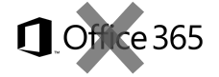
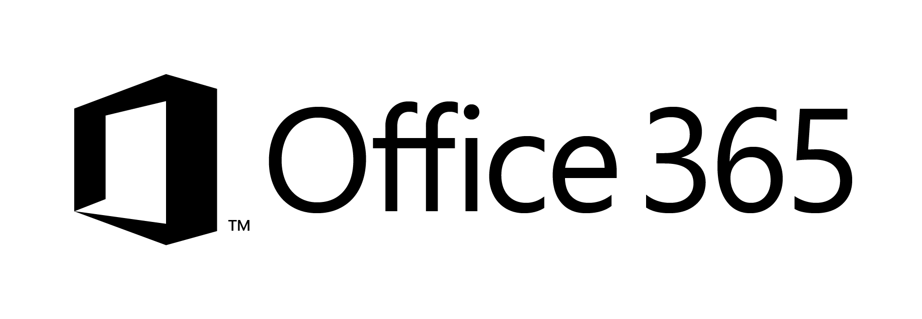

What does add-ins mean in our terminology
SharePoint Add-Ins means all operations which are executed outside of the server
Classic - Full trust solutions
ISV solutions
Client Side Solutions
Remote provisioning for elements
Store Add-Ins
Add-in catalog based solution
Custom service applications
Custom WCF services
Platform level customizations to on-premises
Server side controls as JavaScript on page layouts and master pages
Embracing un-ghosted model
SP add-in dimension with provider hosted add-ins to provide new capabilities
Packaged reusable solutions built for specific functionality
SharePoint customizations, not customer specific customizations
Customer specific customizations
Not only for market place or store, but also as platform for customer specific customizations

Slide 17

What do you really want to achieve?
Notes:
Steve
Time: 28:00

Slide 18
“But add-ins is the pattern for cloud, not for my on premise…”
Really?
Notes:
Steve
Time: 29

Slide 19
What if…
We would use same development model in cloud and in on-premises?
Notes:
Is that Tobias?

Slide 20
SharePoint add-in model
Forget full trust solutions
Embrace un-ghosted deployment models
Run the code outside of the SharePoint context
Much more than just add-in market place
Pattern is also valid for on-premises, not only for Office365
Notes:
Steve
Time: 31:00

Slide 21
Evergreen and release cycle – old model
SP2007
SP2010
SP2013
SP20XX
Upgrade
Upgrade
Upgrade
Upgrade
Specific upgrade project each time new version is introduced
Customizations have to be upgraded to get access on new capabilities in product
Will cause additional costs during each release cycle of customizations
Customization updates cause downtime each time something is changed
Complex ALM processes for ensuring quality of the code
Tightly coupled SharePoint customizations
Notes:
Vesa
Time: 33

Slide 22
Evergreen and release cycle – new model
SP2013
O16
O17
O18
Customizations will utilize services from SharePoint and other services, but won’t usually change out of the box services.
Development
Loosly coupled SharePoint customizations
You choose when and how applications are updated
Backwards compatibility for API level to move customizations cross versions
Customizations don’t block new capabilities from SharePoint
Customizations extend, not change SharePoint
Customizations can be updated with minimal impact on SharePoint
Notes:
Vesa
Time: 35

Slide 23

Denial is the first step…
Product roadmap is clear though…
Notes:
Steve
Time: 37

Slide 24

Remember when feature framework and solutions where introduced…
Notes:
Vesa:
Time: 38

Slide 25

Or when you were told that you’ll have to learn CAML…
Notes:
Steve Time: 39
Eray said we are sorry about that one ☺

Slide 26

SharePoint add-in Development
If you know general web development, you also know SharePoint development…
Notes:
Vesa
Time: 40
How many times have you had to work with Javascript/HTML devs to carve up their solution sot be SharePointy ?

Slide 27
“Will you ever support farm solutions in Office 365?”
No.
Farm solutions are deployed cross SharePoint farm and they’d impact multiple customers…
Notes:
Vesa:
Time: 42:00

Slide 28
“Will you introduce new model for add-in model replacement in near future?”
No.
Add-in model solutions with remote APIs and control are here to stay
Notes:
Steve
Time: 44
NOTE: You may have seen our investments in Common Consent and O365 APIs, this should help you understand that we are investing in evolving this model going forward !!!

Slide 29
“I can’t do XYZ with add-in model?”
There are numerous things which might not be available as such with add-in model, but functional requirements can be achieved using alternative methods
Notes:
Vesa
Time: 45

Slide 30
Recommendations
Align with service and product roadmap
Avoid Sandbox solutions
Move gradually to add-in model
Concentrate on end users
Notes:
Vesa

Slide 31

Questions?

Slide 32
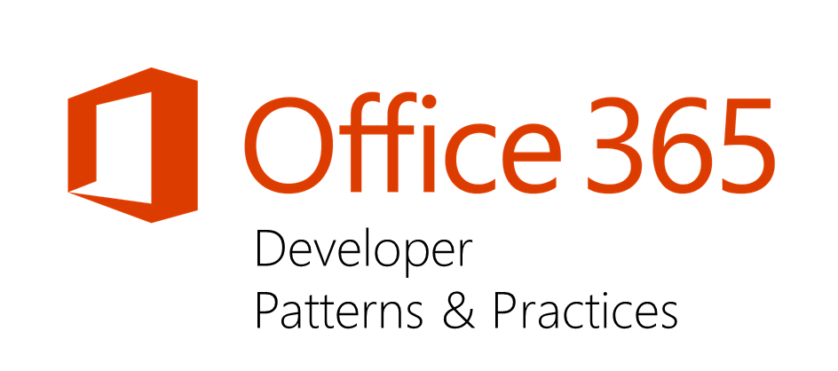
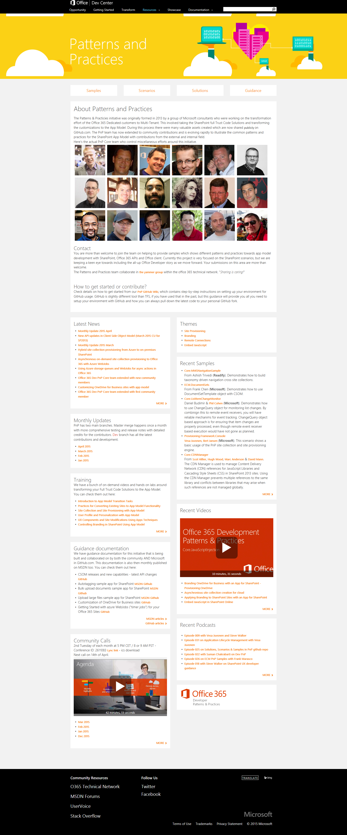
“Sharing is caring”
aka.ms/OfficeDevPnP
aka.ms/OfficeDevPnPYammer
aka.ms/OfficeDevPnPMSDN
aka.ms/OfficeDevPnPVideos
aka.ms/OfficeDevPnPTraining

Slide 33


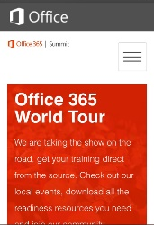
dev.office.com
Sign up
http://dev.office.com/getting-started
Explore
http://apisandbox.msdn.microsoft.com
Get trained http://dev.office.com/training

Slide 34


Feedback
Office 365 Network Share you best practices and join conversations
https://www.yammer.com/itpronetwork
Stackoverflow Ask deep technical questions to a world-wide set of developers
http://stackoverflow.com/questions/tagged/ms-office
UserVoice Provide suggestions of what you want in future versions
http://officespdev.uservoice.com/

Slide 35


© 2015 Microsoft Corporation. All rights reserved. Microsoft, Windows, and other product names are or may be registered trademarks and/or trademarks in the U.S. and/or other countries.
The information herein is for informational purposes only and represents the current view of Microsoft Corporation as of the date of this presentation. Because Microsoft must respond to changing market conditions, it should not be interpreted to be a commitment on the part of Microsoft, and Microsoft cannot guarantee the accuracy of any information provided after the date of this presentation. MICROSOFT MAKES NO WARRANTIES, EXPRESS, IMPLIED OR STATUTORY, AS TO THE INFORMATION IN THIS PRESENTATION.

